Slide 1
Processes

Slide 2
Overview
Multithreading - for higher performance
Virtualization
Clients
Servers
Code Migration

Slide 3
Processes
Communication takes place between processes.
process: A program in execution
Traditional operating systems: concerned with the “local” management and scheduling of processes.
Modern distributed systems: a number of other issues are of equal importance

Slide 4
Problems with Processes
Creating and managing processes is generally regarded as an expensive task
Making sure all the processes peacefully co-exist on the system is not easy
Threads can be thought of as an “execution of a part of a program”
Rather than make the OS responsible for concurrency transparency, it is left to the individual application to manage the creation and scheduling of each thread.

Slide 5
Introduction to Threads
Modern OSs provide “virtual processors” within which programs execute.
A programs execution environment is documented in the process table and assigned a PID.
To achieve acceptable performance in distributed systems, relying on the OS’s idea of a process is often not enough – finer granularity is required.
The solution: Threading.

Slide 6
Threads
Thread executes its own piece of code, independently from other threads.
No attempt is made to achieve a high degree of concurrency transparency if this would result in performance degradation
A thread system generally maintains only the minimum information to allow a CPU to be shared by several threads

Slide 7
Important Implications
Two Important Implications:
Threaded applications often run faster than non-threaded applications as context-switches between kernel and user-space are avoided
Threaded applications are harder to develop
Additionally, the assumption is that the development environment provides a Threads Library for developers to use

Slide 8
Threads in Non-Distributed Systems
Advantages
Threads minimize the context switching time.
Use of threads provides concurrency within a process.
Efficient communication.
It is more economical to create and context switch threads.
Threads allow utilization of multiprocessor architectures to a greater scale and efficiency.

Slide 9
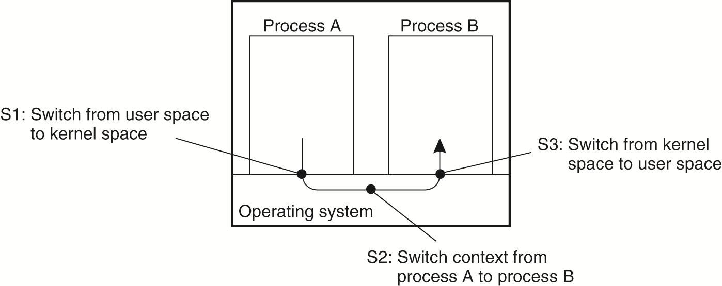
Thread Usage in Non distributed Systems
Fig: Context switching in processes as the result of IPC.

Slide 10
Thread Implementation
Threads are often provided in the form of a thread package contains operations to create and destroy threads as well as operations on synchronization variables.
Two approaches to implement a thread package.
The first approach is to construct a thread library that is executed entirely in user mode.
The second approach is to have the kernel be aware of threads and schedule them

Slide 11
Thread Implementation
Threads are implemented in following ways −
User space Threads − User managed threads.
Kernel Level Threads − Operating System managed threads acting on kernel, an operating system core.
Hybrid model

Slide 12
User-space threads
The thread management kernel is not aware of the existence of threads.
The thread library contains code for creating and destroying threads, for passing message and data between threads, for scheduling thread execution and for saving and restoring thread contexts.
The application starts with a single thread.

Slide 13
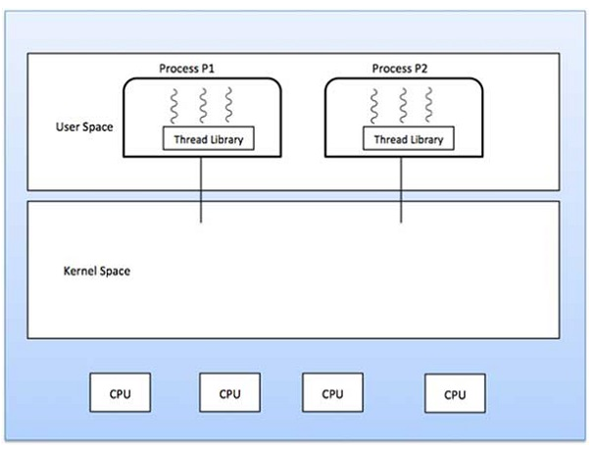
User-space threads

Slide 14
User-space threads
Advantages
Thread switching does not require Kernel mode privileges.
User level thread can run on any operating system.
Scheduling can be application specific in the user level thread.
User level threads are fast to create and manage.
Disadvantages
In a typical operating system, most system calls are blocking.
Multithreaded application cannot take advantage of multiprocessing.

Slide 15
Kernel-space threads
Thread management is done by the Kernel.
There is no thread management code in the application area.
Kernel threads are supported directly by the operating system.
Any application can be programmed to be multithreaded.
All of the threads within an application are supported within a single process.

Slide 16
Kernel-space threads
The Kernel maintains context information for the process as a whole and for individuals threads within the process.
Scheduling by the Kernel is done on a thread basis.
The Kernel performs thread creation, scheduling and management in Kernel space.
Kernel threads are generally slower to create and manage than the user threads.

Slide 17
Kernel-space threads
Advantages
Kernel can simultaneously schedule multiple threads from the same process on multiple processes.
If one thread in a process is blocked, the Kernel can schedule another thread of the same process.
Kernel routines themselves can be multithreaded.
Disadvantages
Kernel threads are generally slower to create and manage than the user threads.
Transfer of control from one thread to another within the same process requires a mode switch to the Kernel.

Slide 18
Hybrid model
Some operating system provide a combined user level thread and Kernel level thread facility.
In a combined system, multiple threads within the same application can run in parallel on multiple processors and a blocking system call need not block the entire process.
Multithreading models are three types
Many to many relationship.
Many to one relationship.
One to one relationship.

Slide 19
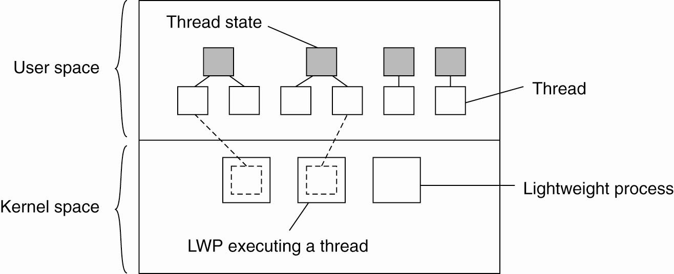
Thread Implementation
Combining kernel-level lightweight processes
and user-level threads

Slide 20
Many to Many Model
The many-to-many model multiplexes any number of user threads onto an equal or smaller number of kernel threads.
In this model, developers can create as many user threads as necessary and the corresponding Kernel threads can run in parallel on a multiprocessor machine.
This model provides the best accuracy on concurrency and when a thread performs a blocking system call, the kernel can schedule another thread for execution.

Slide 21
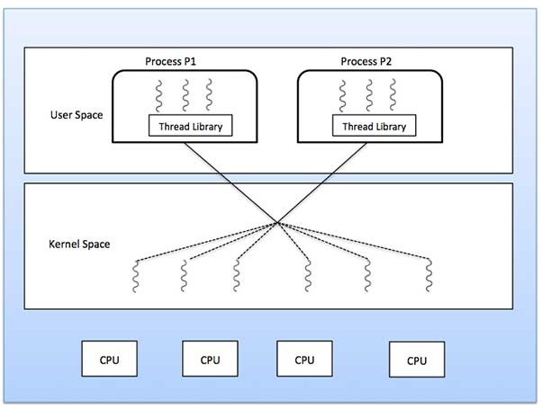
Many to Many Model

Slide 22
Many to One Model
Many-to-one model maps many user level threads to one Kernel-level thread.
Thread management is done in user space by the thread library.
When thread makes a blocking system call, the entire process will be blocked.
Only one thread can access the Kernel at a time, so multiple threads are unable to run in parallel on multiprocessors.

Slide 23
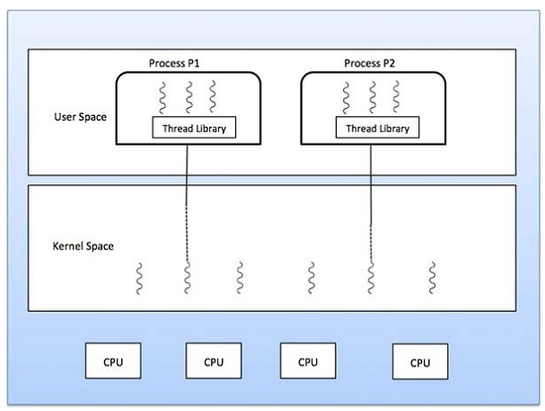
Many to One Model

Slide 24
One to One Model
There is one-to-one relationship of user-level thread to the kernel-level thread.
This model provides more concurrency than the many-to-one model.
It also allows another thread to run when a thread makes a blocking system call.
It supports multiple threads to execute in parallel on microprocessors.

Slide 25
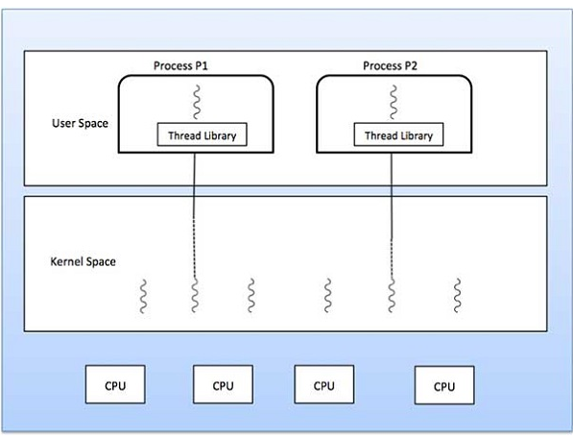
One to One Model

Slide 26
Threads in Distributed Systems
Important characteristic: a blocking call in a thread does not result in the entire process being blocked.
This leads to the key characteristic of threads within distributed systems:
We can now express communications in the form of maintaining multiple logical connections at the same time as opposed to a single, sequential, blocking process

Slide 27
Multithreaded Clients
Multiple threads can be used to hide delays in network communications.
For example, a web browser can start up several threads, one for downloading the HTML source of the page, one each for images on the page, one each for animations/applets etc.
Replicated web servers along with multi-threaded clients can result in shorter download times

Slide 28
Multithreaded Servers
The main use of multithreading in distributed systems is found at the server side.
Multithreading simplifies server code and also makes it easier to develop servers that exploit parallelism to attain high performance, even on uniprocessor systems

Slide 29
Multithreaded Servers
one thread, the dispatcher, reads incoming requests for a file operation. The requests are sent by clients to a well-known end point for this server.
After examining the request, the server chooses an idle worker thread and hands it the request.
The worker blocks read on the local file system which may cause the thread to be suspended until the data are fetched from disk.
If the thread is suspended, another thread is selected to be executed

Slide 30
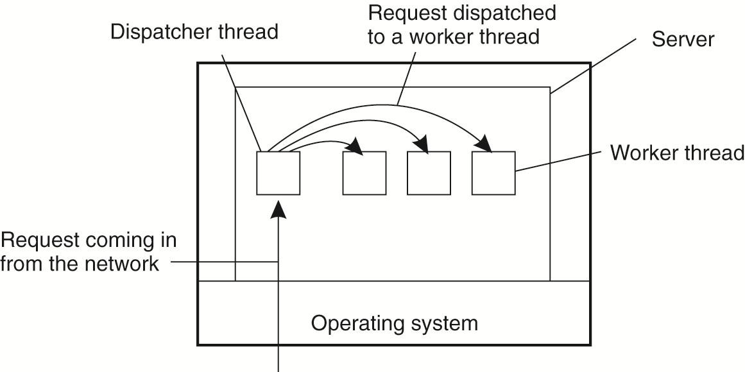
Multithreaded Servers
Fig: A multithreaded server organized in a dispatcher/worker model

Slide 31
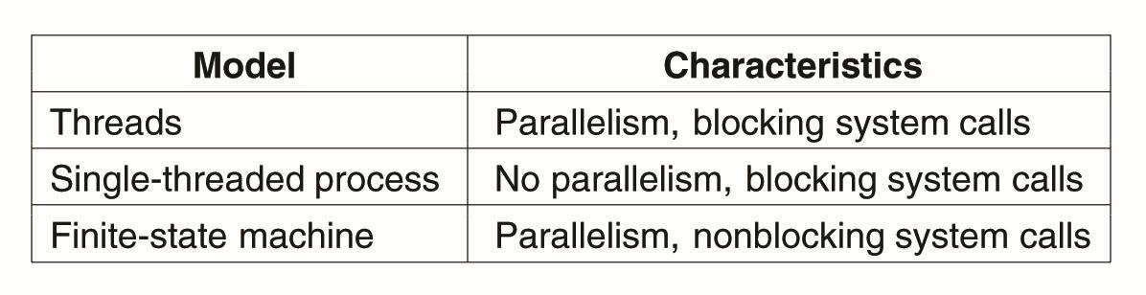
Multithreaded Servers
Fig: Three ways to construct a server

Slide 32
Virtualization
Virtualization is the creation of a virtual rather than actual version of something, such as a hardware platform, operating system, a storage device or network resources.
Eases administration of large number of servers or resources
Helps with scalability and better utilization of hardware resources

Slide 33
The Role of Virtualization in Distributed Systems
Every distributed computer system offers a programming interface to higher level s/w
virtualization deals with extending or replacing an existing interface so as to mimic the behavior of another system

Slide 34
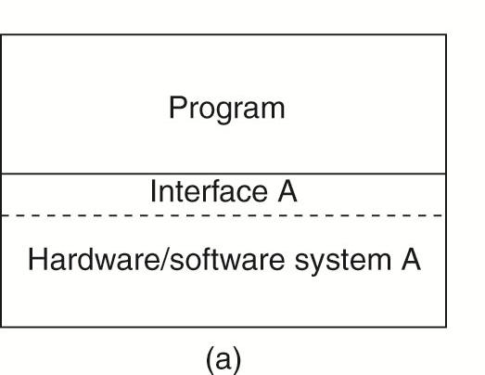
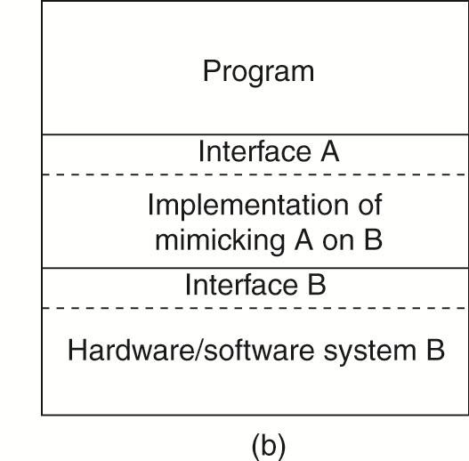
The Role of Virtualization in Distributed Systems
(a) General organization between a program, interface, and system.
(b) General organization of virtualizing system A on top of system B.

Slide 35
The Role of Virtualization in Distributed Systems
The hardware and low-level systems software change reasonably fast, software at higher levels of abstraction are much more stable
Legacy software cannot be maintained in the same pace as the platforms it relies on.
Virtualization can help by porting the legacy interfaces to the new platforms

Slide 36
The Role of Virtualization in Distributed Systems
The networking has become completely pervasive.
Modern computer systems are heterogeneous collection of server computers, each one running very different applications, which can be accessed by clients.
At the same time the various resources should be easily accessible to these applications.
Virtualization can help a lot: the diversity of platforms and machines can be reduced by letting each application run on its own virtual machine, including the related libraries and operating system which run on a common platform.
virtualization provides a high degree of portability and flexibility.

Slide 37
Architectures of Virtual Machines
There are many different ways in which virtualization can be realized.
computer systems generally offer four different types of interfaces, at four different levels:
An interface between the hardware and software consisting of machine instructions
that can be invoked by any program.
An interface between the hardware and software, consisting of machine instructions
that can be invoked only by privileged programs, such as an operating system.

Slide 38
Architectures of Virtual Machines
3. An interface consisting of system calls as offered by an operating system.
4. An interface consisting of library calls
– generally forming what is known as an application programming interface (API).
–In many cases, the aforementioned system calls are hidden by an API.

Slide 39
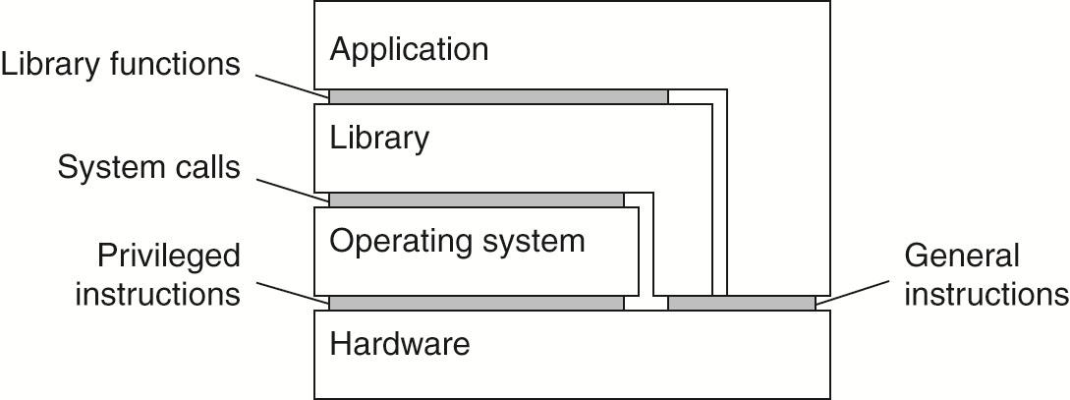
Architectures of Virtual Machines
Various interfaces offered by computer systems

Slide 40
Architectures of Virtual Machines
Virtualization can be implemented at two levels.
Process Virtual Machine: An abstract instruction set that is to be used for executing applications.
For example: Java runtime, Windows emulation (Wine) on Unix/Linux/ MacOS.
Virtual Machine Monitor: A layer completely shielding the original hardware but offering the complete instruction set of that same or other hardware as an interface.
Makes it possible to have multiple instances of different operating systems run simultaneously on the same platform.
Examples: Vmware, VirtualBox, Xen, VirtualPC, Parallels etc

Slide 41
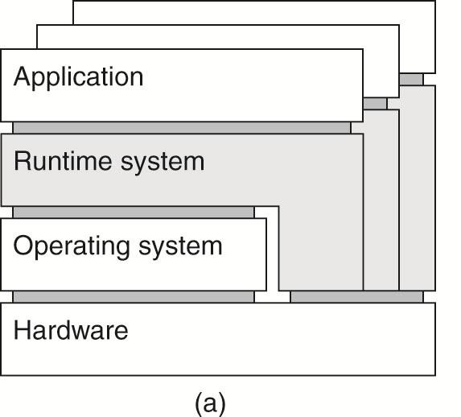
Architectures of Virtual Machines
A process virtual machine, with multiple instances of (application, runtime) combinations.

Slide 42
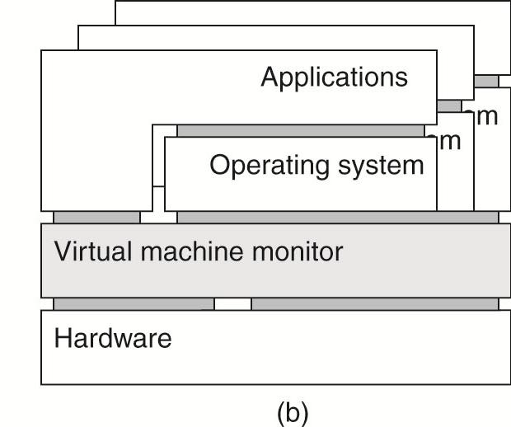
Architectures of Virtual Machines
A virtual machine monitor, with multiple instances of (applications, operating system) combinations

Slide 43
Design Issues for Clients
A major task of client machines is to provide the means for users to interact with remote servers.
There are 2 two ways in which this interaction can be supported.
First, for each remote service the client machine will have a separate counterpart that can contact the service over the network.
A second solution is to provide direct access to remote services by only offering a convenient user interface

Slide 44
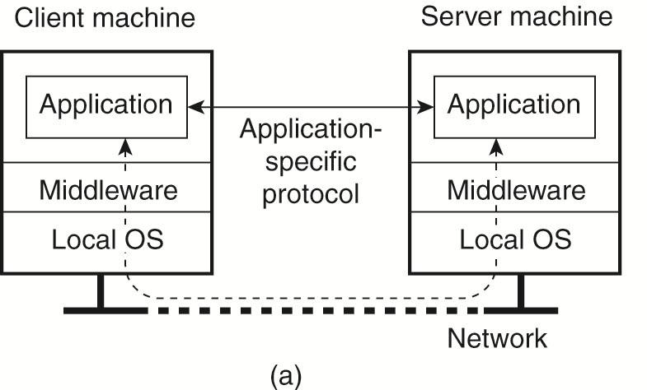
Networked User Interfaces
A networked application with its own protocol

Slide 45
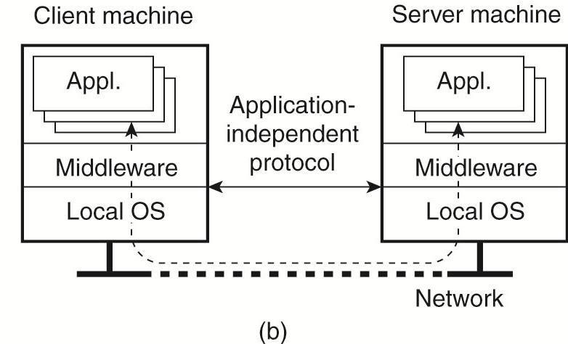
Networked User Interfaces
A general solution to allow access to remote applications.

Slide 46
Client-Side Software for Distribution Transparency
In many cases, parts of the processing and data level in a client-server application are executed on the client side as well
Besides the user interface and other application-related software, client software comprises components for achieving distribution transparency
a client should not be aware that it is communicating with remote processes.
In contrast, distribution is often less transparent to servers for reasons of performance and correctness

Slide 47
Client-Side Software for Distribution Transparency
Access transparency is generally handled through the generation of a client stub from an interface definition of what the server has to offer
The stub provides the same interface as available at the server, but hides the possible differences in machine architectures, as well as the actual communication.

Slide 48
Client-Side Software for Distribution Transparency
Many distributed systems implement replication transparency by means of client-side solutions.
Replication transparency ensures that replication of databases are hidden from the users
In a distributed system with replicated servers, Such replication can be achieved by forwarding a request to each replica.
Client-side software can transparently collect all responses and pass a single response to the client application

Slide 49
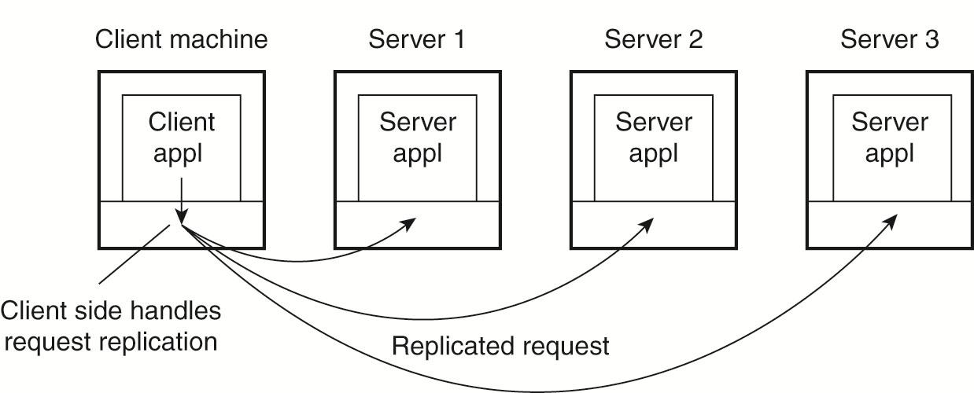
Client-Side Software for Distribution Transparency
Transparent replication of a server using a client-side solution

Slide 50
Client-Side Software for Distribution Transparency
Replication transparency is associated with concurrency transparency and failure transparency.
concurrency transparency: Whenever a user updates a data item, the update is reflected in all the copies of the table. , this operation should not be known to the user.
Concurrency transparency can be handled through special intermediate servers and requires less support from client software.

Slide 51
Client-Side Software for Distribution Transparency
Failure transparency: In case of failure of a site, the user can still proceed with his queries using replicated copies without any knowledge of failure.
Masking communication failures with a server is typically done through client middleware.
Persistence transparency is often completely handled at the server.

Slide 52
Design Issues for Servers
A server is a process implementing a specific service on behalf of a collection of clients
Each server is organized in the same way: it waits for an incoming request from a client and subsequently ensures that the request is taken care of, after which it waits for the next incoming request
There are several ways to organize servers
How a server handle request
where clients contact a server
how a server can be interrupted
whether or not the server is stateless

Slide 53
Design Issues for Servers
How a server handle request
A server can be iterative or concurrent
Iterative server: server itself handles the request and, if necessary, returns a response to the requesting client
Concurrent server: server does not handle the request itself, but passes it to a separate thread or another process, after which it immediately waits for the next incoming request
Concurrent servers can be multi-threaded or multi-process

Slide 54
Servers: Design Issues
where clients contact a server
In all cases, clients send requests to an end point, called a port, at the machine where the server is running.
Each server listens to a specific end point
How does a client find a server? Need to know the end-point or port and the host address
Statically assigned like well known servers like HTTP on port 80
Look-up service provided by a special directory server
Using a super server that selects on multiple ports and forks off the appropriate server when a request comes in

Slide 55
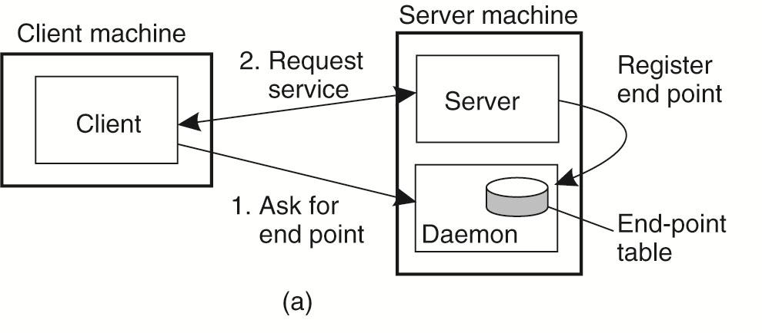
General Design Issues
Client-to-server binding using a daemon

Slide 56
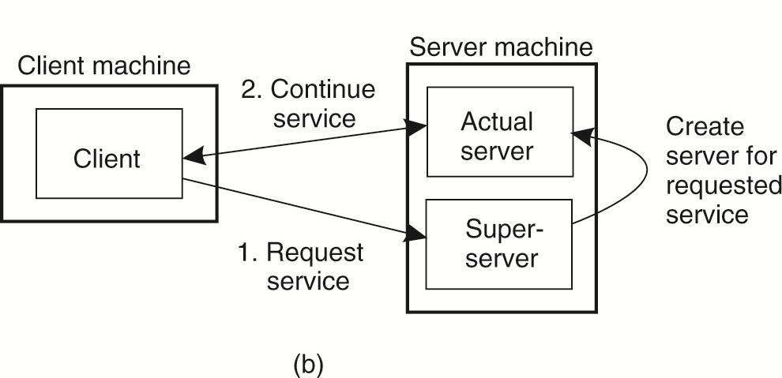
General Design Issues
Client-to-server binding using a superserver

Slide 57
Servers: Design Issues
how a server can be interrupted
One approach is abruptly exit the client application which will automatically break the connection to the server, immediately restart it, and pretend nothing happened.
The server will eventually tear down the old connection, thinking the client has probably crashed.

Slide 58
Servers: Design Issues
Other approach
How to handle communication interrupts? Use out-of-band data.
Example: to cancel the upload of a huge file
Server listens to separate endpoint, which has higher priority, while also listening to the normal endpoint (with lower priority)
Send urgent data on the same connection. Can be done with TCP, where the server gets a signal (SIGURG) on receiving urgent data

Slide 59
Servers: Design Issues
whether or not the server is stateless
Stateless servers. A stateless server does not remember anything from one request to another. For example, a HTTP server is stateless. Cookies can be used to transmit information specific to a client with a stateless server. Easy to recover from a crash.
Stateful servers. Maintains information about its clients. Performance improvement over stateless servers is often the reason for stateful servers. Needs to recover its entire state as it was just before crash. Can be quite complex for distributed servers.
Soft state: The server promises to maintain state on behalf of the client, but only for a limited time

Slide 60
Server Clusters
Server cluster is a collection of machines connected through a network, where each machine runs one or more servers.
The server clusters are the ones in which the machines are connected through a local-area network, often offering high bandwidth and low latency.
Generally, a server cluster is logically organized into three tiers
First tier consists of a logical switch through which client requests are routed

Slide 61
Server Clusters
Second tier: many server clusters also contain servers dedicated to application processing.
These servers running on high-performance hardware dedicated to delivering compute power
Third tier: which consists of data-processing servers, notably file and database servers.
Depending on the usage of the server cluster, these servers may be running an specialized machines, configured for high-speed disk access and having large server-side data caches.

Slide 62
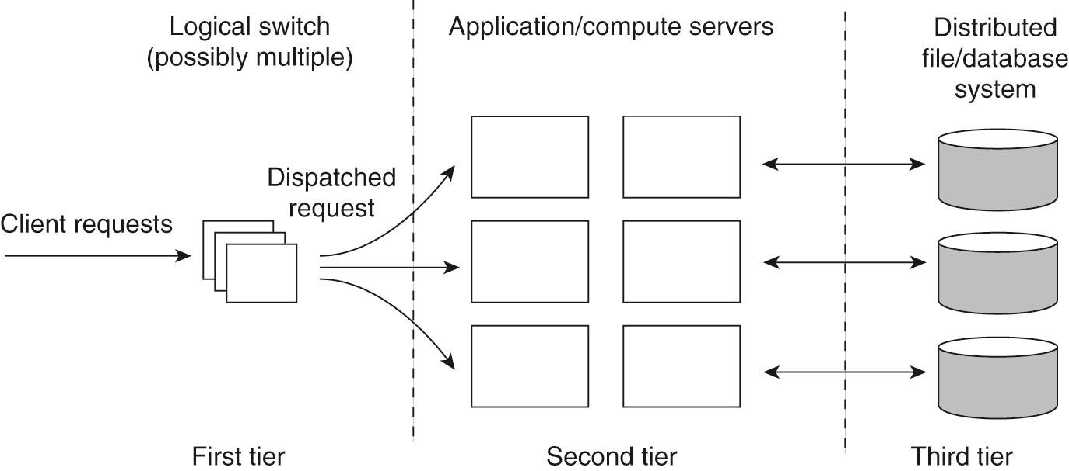
Server Clusters
The general organization of a three-tiered server cluster

Slide 63
Server Clusters
Standard way of accessing a server cluster is to set up a TCP connection over which application-level requests are then sent as part of a session.
A session ends by tearing down the connection
In the case of transport-layer switches, the switch accepts incoming TCP connection requests, and hands off such connections to one of the server
The principle working is known as TCP handoff
When the switch receives a TCP connection request, it identifies the best server for handling that request, and forwards the request packet to that server.
The server will send an acknowledgment back to the requesting client.

Slide 64
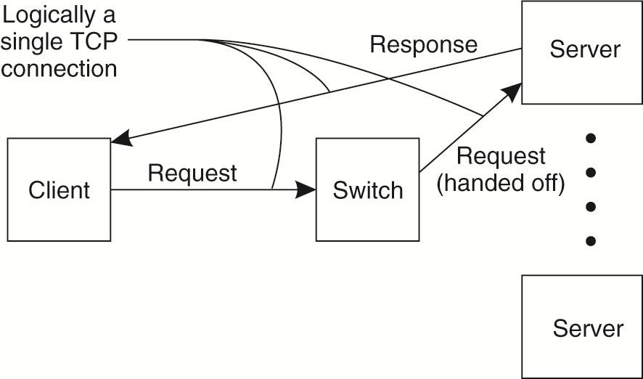
Server Clusters
The principle of TCP handoff

Slide 65
Server Clusters
Switch can hand off connections in round-robin and thus be oblivious of the service being provided
Switch can handoff request based on type of service requested to the appropriate server
Switch can handoff request based on server loads
Switch can handoff request by being aware of the content
Single point of access can be made better using DNS to map one hostname to several servers. But the client still has to try multiple servers in case some are down

Slide 66
Distributed Servers
A distributed server is a possibly dynamically changing set of machines, with also possibly varying access points, but which nevertheless appears to the outside world as a single, powerful machine
A stable access point across a distributed server can be implemented using mobility support for IPv6 (MIPv6)
home network: where a mobile node normally resides
home address (HoA): stable address for a node in its home network
care of address (CoA): when a mobile node attaches to a foreign network, its sets up a forwarding from its HoA to the CoA
route optimization from MPIv6 is used to make different clients believe they are communicating with a single server where, in fact, each is communicating with a different member node of the distributed server

Slide 67
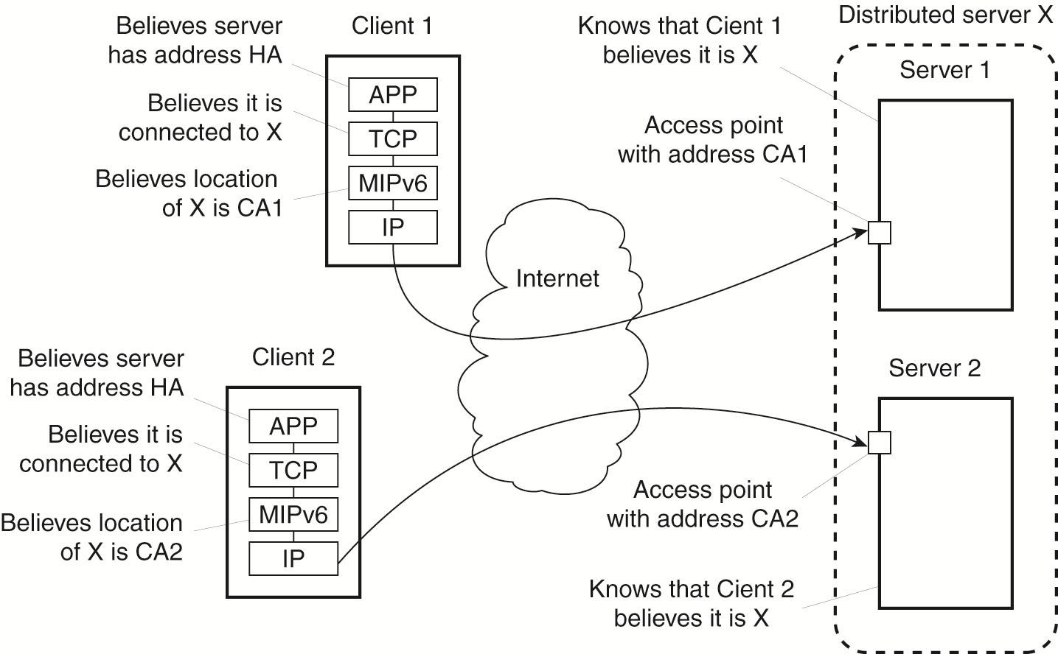
Distributed Servers
Route optimization in a distributed server

Slide 68
Managing Server Clusters
An administrator manually logs in to each server to manage them. Or they use shell scripts or simple tools to manage a collection of servers
An management interface is provided at one system to collectively manage the cluster of servers
However to go to the level of thousands or more of servers, most administration approaches are ad hoc and still an active area of research
Large server cluster farms are increasing rapidly! Google is said to operate over a million servers in 12 farms

Slide 69
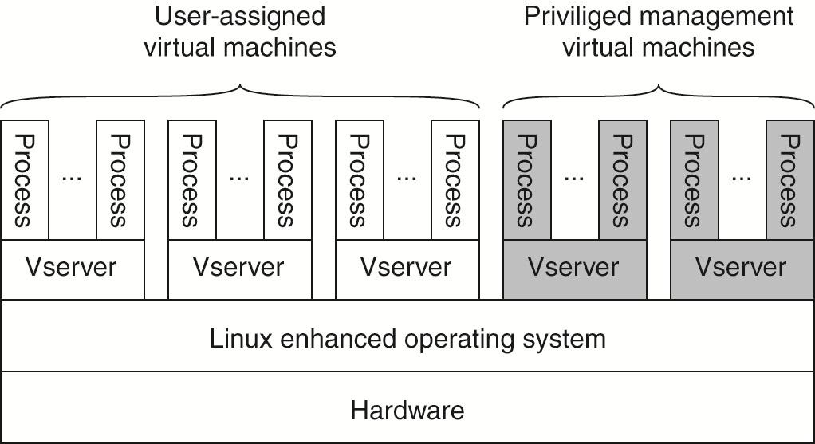
Managing Server Clusters Example: PlanetLab
The basic organization of a PlanetLab node

Slide 70
PlanetLab
PlanetLab management issues:
Nodes belong to different organizations.
–Each organization should be allowed to specify who is allowed to run applications on their nodes
–Restrict resource usage appropriately.
Monitoring tools available assume a very specific combination of hardware and software.
–All tailored to be used within a single organization.
Programs from different slices but running on the same node should not interfere with each other

Slide 71
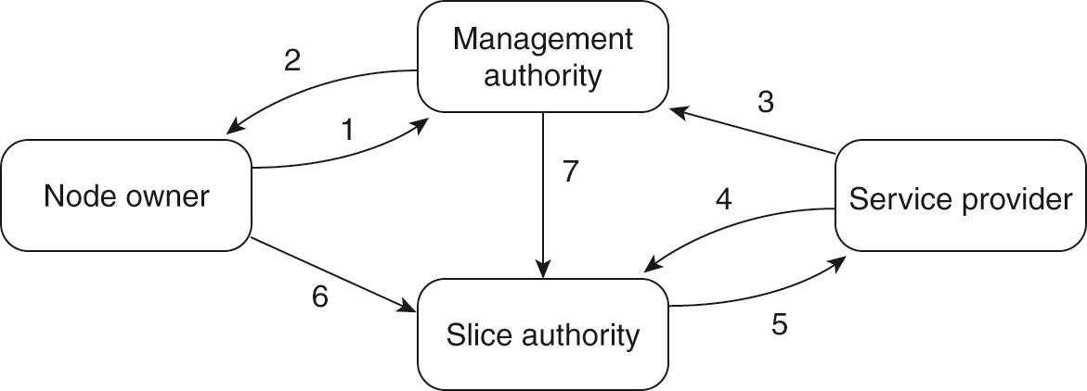
PlanetLab
The management relationships betwee various PlanetLab entities

Slide 72
PlanetLab
Relationships between PlanetLab entities:
A node owner puts its node under the regime of a management authority, possibly restricting usage where appropriate.
A management authority provides the necessary software to add a node to PlanetLab.
A service provider registers itself with a management authority, trusting it to provide well-behaving nodes.

Slide 73
PlanetLab
Relationships between PlanetLab entities:
A service provider contacts a slice authority to create a slice on a collection of nodes
The slice authority needs to authenticate the service provider
A node owner provides a slice creation service for a slice authority to create slices. It essentially delegates resource management to the slice authority
A management authority delegates the creation of slices to a slice authority

Slide 74
Reasons for Migrating Code
Improve computing performance by moving processes from heavily-loaded machines to lightly loaded machines.
Improve communication times by shipping code to systems where large data sets reside. E.g. a client ships code to a database server or vice versa.
Mobile Agents: small piece of code that moves from site to site for a web search. Several copies can be made to improve performance.
Flexibility to dynamically configure distributed systems. E.g. a server can provide interface code to a client dynamically. This does the require that the protocol for downloading and initializing the code is standardized. Allows the interface to be changed as often as desired without having to rebuild applications or servers

Slide 75
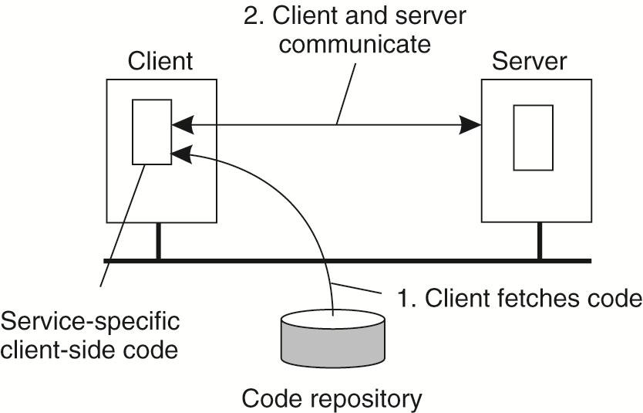
Reasons for Migrating Code
The principle of dynamically configuring a client to communicate to a server. The client first fetches the necessary software, and then invokes the server

Slide 76
Code Migration Models
A process consists of three segments: code segment, resource segment, execution segment.
Weak mobility: Only the code segment (and some initialization data) can be transferred. Transferred program always starts at one of the predefined starting positions. E.g. java applets.
Strong mobility: Code and execution segments can both be transferred.
Sender-initiated versus receiver-initiated: Uploading code to a server versus downloading code from a server by a client.

Slide 77
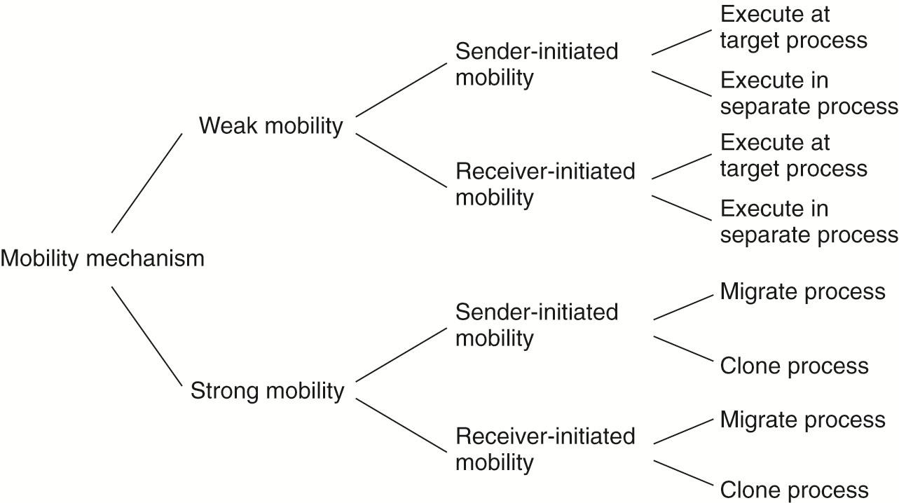
Models for Code Migration
Alternatives for code migration
Alternatives for code migration

Slide 78
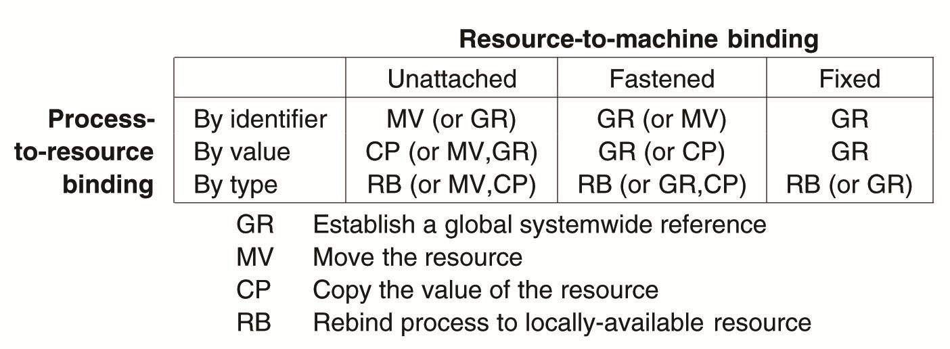
Migration and Local Resources
Actions to be taken with respect to the references to local resources when migrating code to another machine

Slide 79
Migration in Heterogeneous Systems
Three ways to handle migration which can be combined
Pushing memory pages to the new machine and resending the ones that are later modified during the migration process.
Stopping the current virtual machine; migrate memory, and start the new virtual machine.
Letting the new virtual machine pull in new pages as needed, that is, let processes start on the new virtual machine immediately and copy memory pages on demand.

